Slide 1

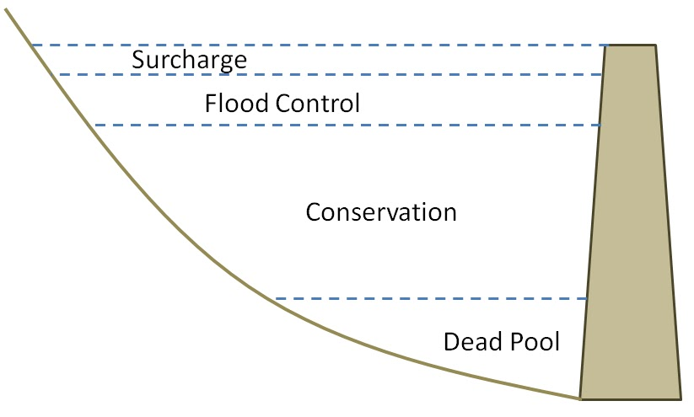
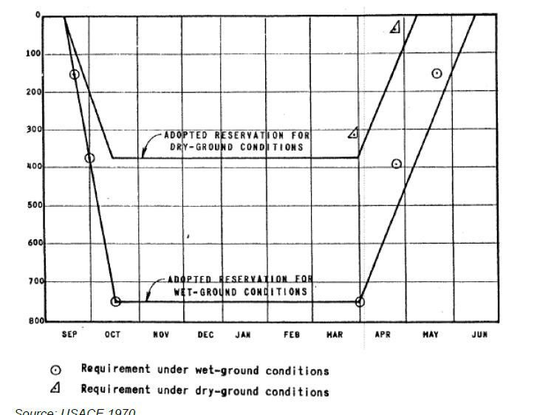

HOMEWORK 10 (Due May 20th)
Establishing Area Versus Elevation relationship for artificial reservoirs
Quantifiying the trend of drying of two classic cases of natural lakes (tragedy of the commons)
A. In water resources, it is often necessary to know what the surface area of an artificial reservoir corresponds to for a given elevation (height). This helps compute the volume/storage changes (since it is not feasible to always go out with a sonar). The volume-height relationship then has multiple uses such as i) flood routing, ii) reservoir management (hydropower, water supply, irrigation etc.) iii) hydro-climatic studies iv) sea-level rise debate etc. etc.
Month
C
E
E

Slide 2
HOMEWORK 10 (Continued)
Establishing Area Versus Elevation relationship for artificial reservoirs
Once you have created an account in HydroWeb, you are to focus on the following 2 locations (note: it takes a day to get access):
Lake Mead
Lake Powell
It should be fairly obvious how to get to the specific page for each reservoir (I will do a demostration as needed).
For each of these two sites, define a period of at least 5 years. Next, download text data on:
Reservoir levels
Reservoir surface area (corresponding to levels and same period) (Note: surface area is not measured by altimeter; normally we would classify this from different source of remote sensing such as MODIS in optical or near-IR range or Landsat; here it is already classified for you to make your life easy).
Establish the height versus area curve – just plot it and idealize the form through a power law function
C
E
E

Slide 3
HOMEWORK 10 (Continued)
Establishing Area Versus Elevation relationship for artificial reservoirs
4) Next, establish height versus volume variations (how would you do it? – assume trapezoidal cross section between two successive levels).
5) Verify your height versus volume variation with what is already provided on the website at HYDROWEB for the specific reservoir
6) How are the two reservoirs different?
7) Write the very basics of points 1 through 6 with images as needed and submit it as a homework solution. I want to see clear answers for each point.
B. Tragedy of the Commons: the Story of Aral Sea
Similar to what you did for Lake Mead and Lake Powell, focus now on Aral Sea (South). It is located in Asia so you have click on that map or list accordingly.
In this part, you have to identify the year the volume of the Aral sea reduced to 50% of pre-1990 levels. State how you came to that answer and make assumptions accordingly.
C
E
E

